Slide 1
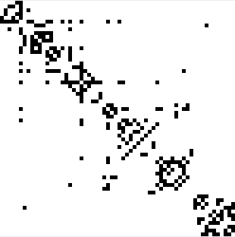




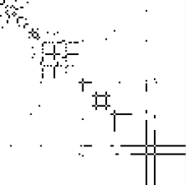

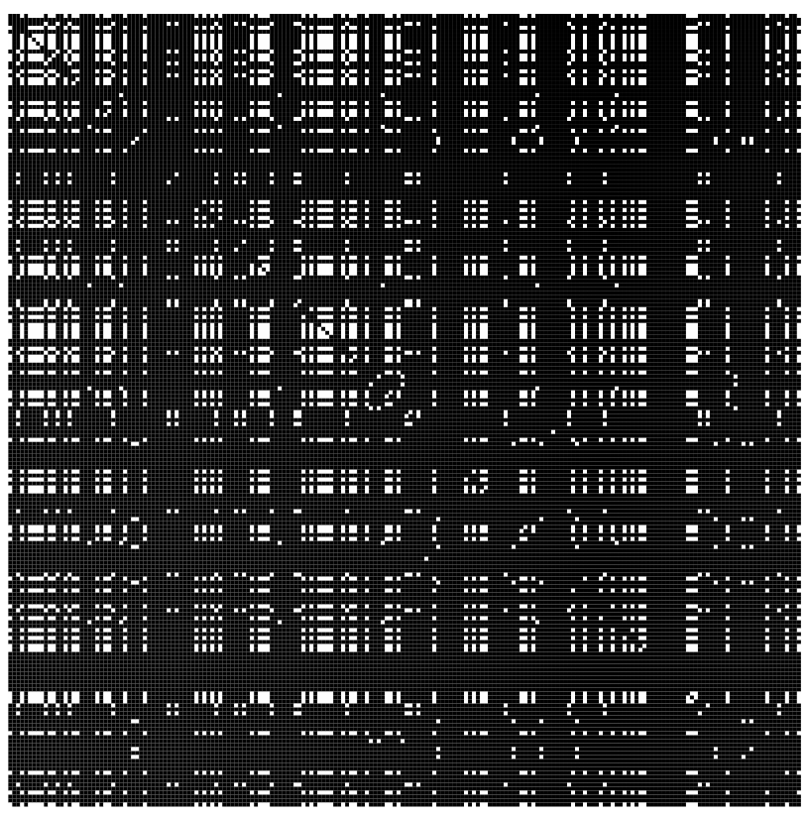
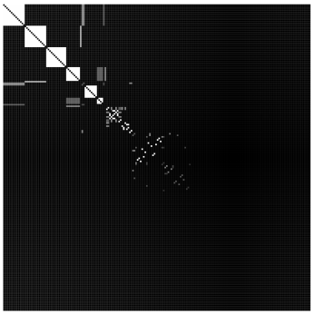
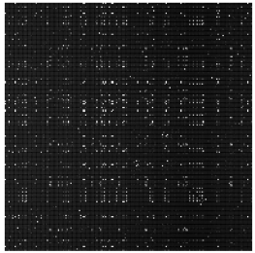
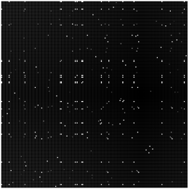
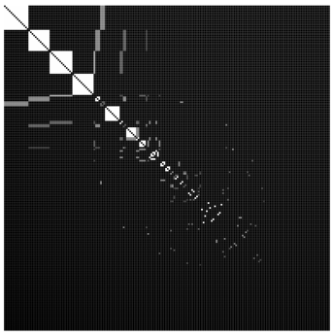
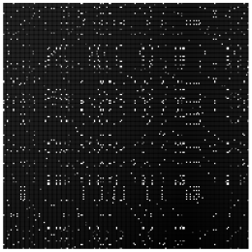

Multiple Matrices of varying Size
2D Representation & Graph Matching
Applications
Ranking
Outlier
$$≈$$
…
…
Clustering
Sorting
PlaceholderMainDiagramPipeline
2D Projection
Nearest Neigbors
Similarity

Slide 2

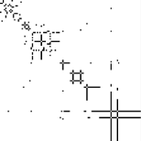

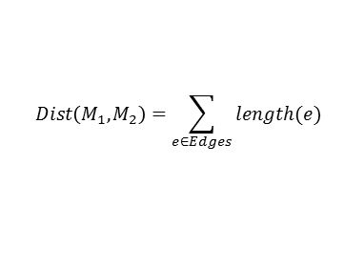
Multiple Matrices of varying Size
Distance Function based on 2D Projection and Graph Matching
Distance Calculation
M₁
M₂
Distance
…
…
#Edges
$$Dist\left(M_{1},M_{2}\right)=\sum_{e∈Edges}{length(e)}$$
FinalMainDiagramPipeline
2D Projection
Nearest Neigbors
Similarity

Slide 3
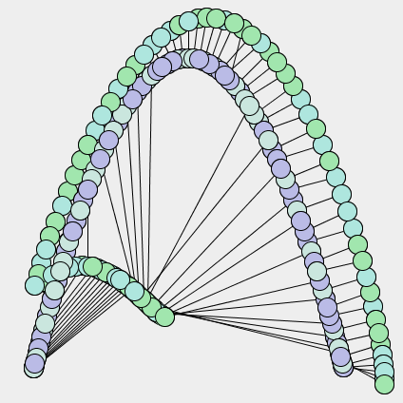

Matrix Projection Explorer
splash

Slide 4
Matrix Projection Explorer
Splash_nologo

Slide 5
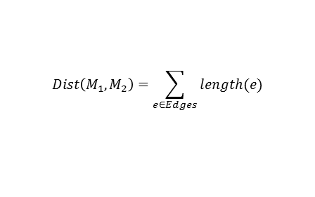
Matrix Projection Explorer
Multiple Matrices of varying Size
Distance Function based on 2D Projection and Graph Matching
Distance Calculation
M₁
M₂
Distance
…
…
#Edges
$$Dist\left(M_{1},M_{2}\right)=\sum_{e∈Edges}{length(e)}$$

Slide 6
Placeholder

Slide 7
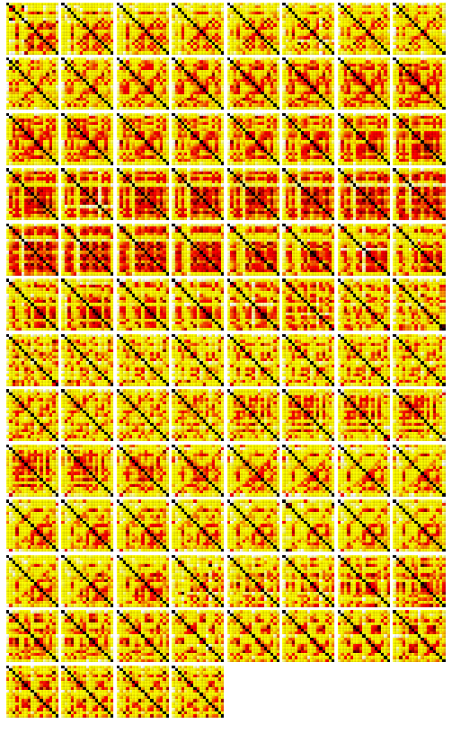
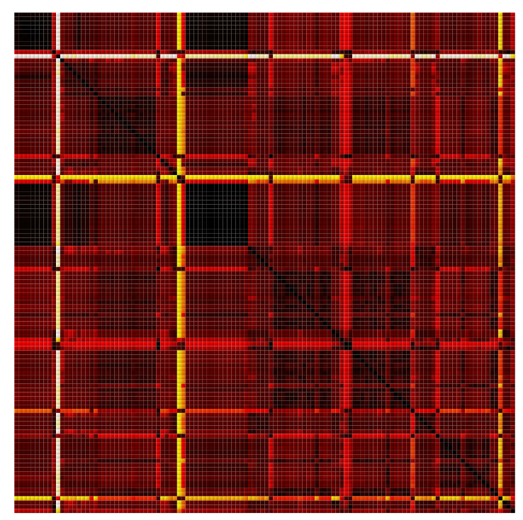
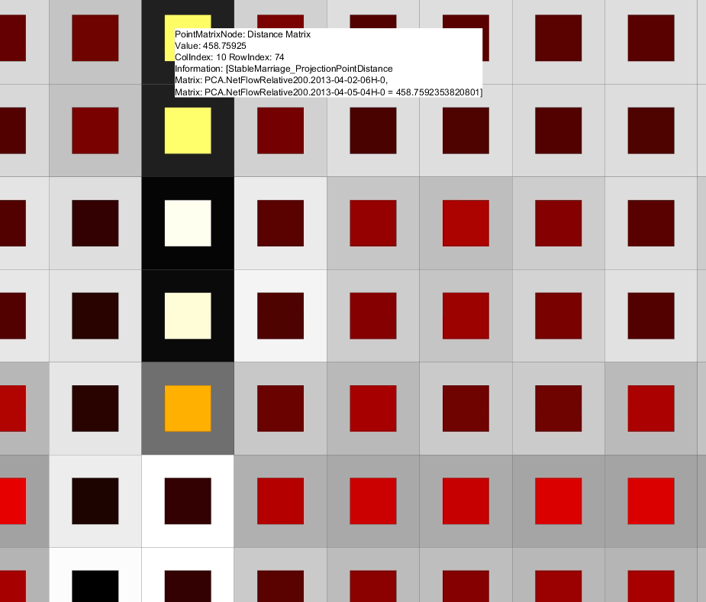
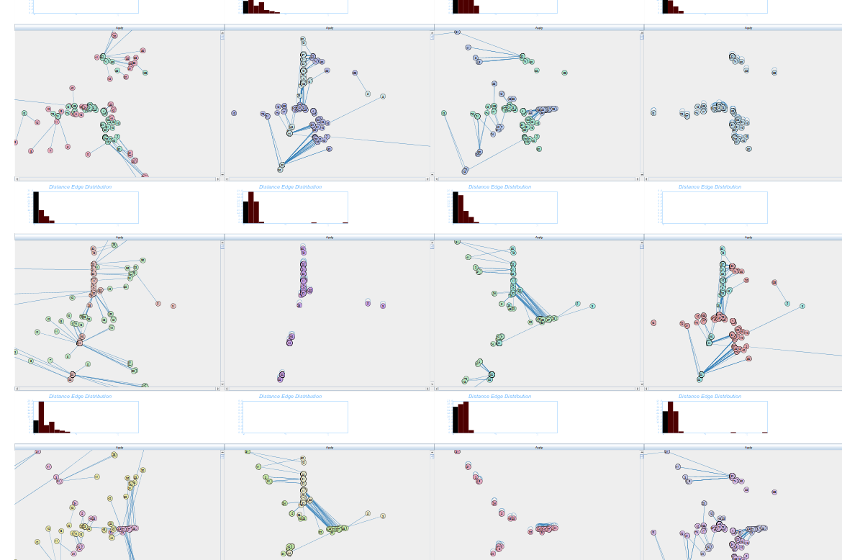
Placeholder Not Final Images
(a)
(b)
(c)
(d)
PlaceholderSemanticZoom1

Slide 8
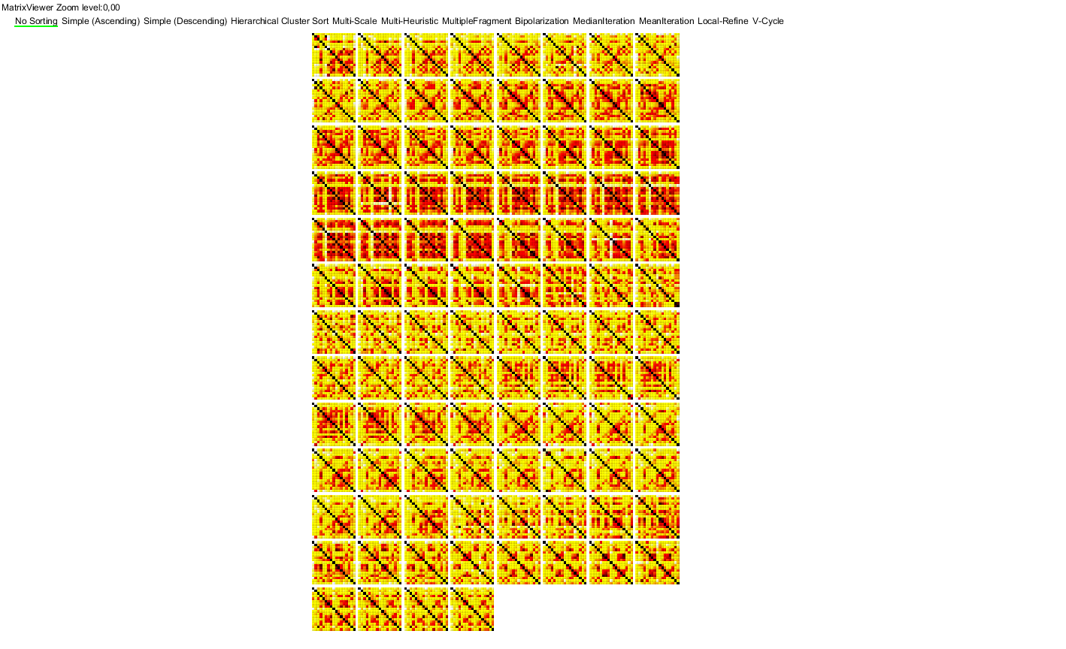
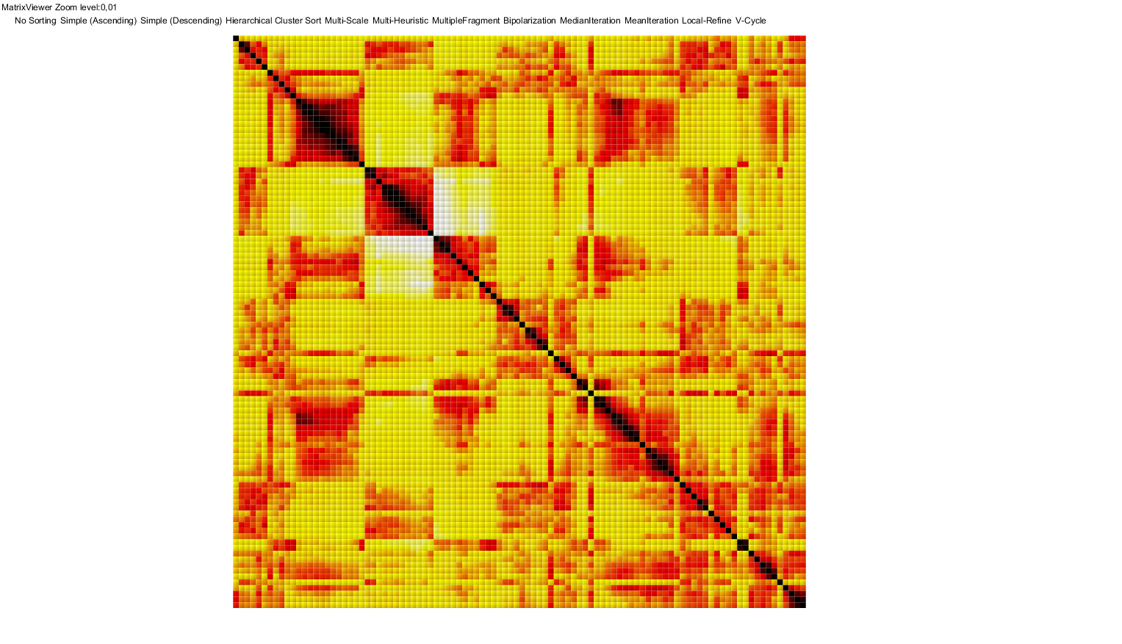
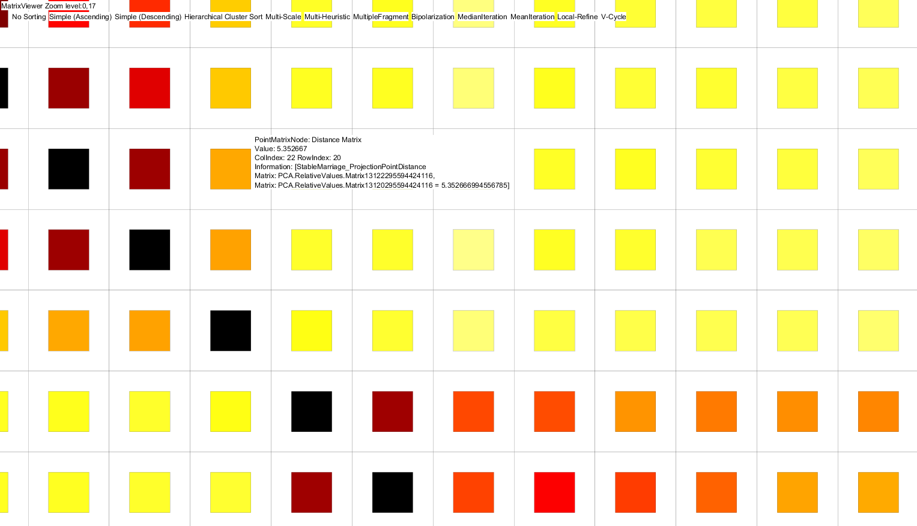
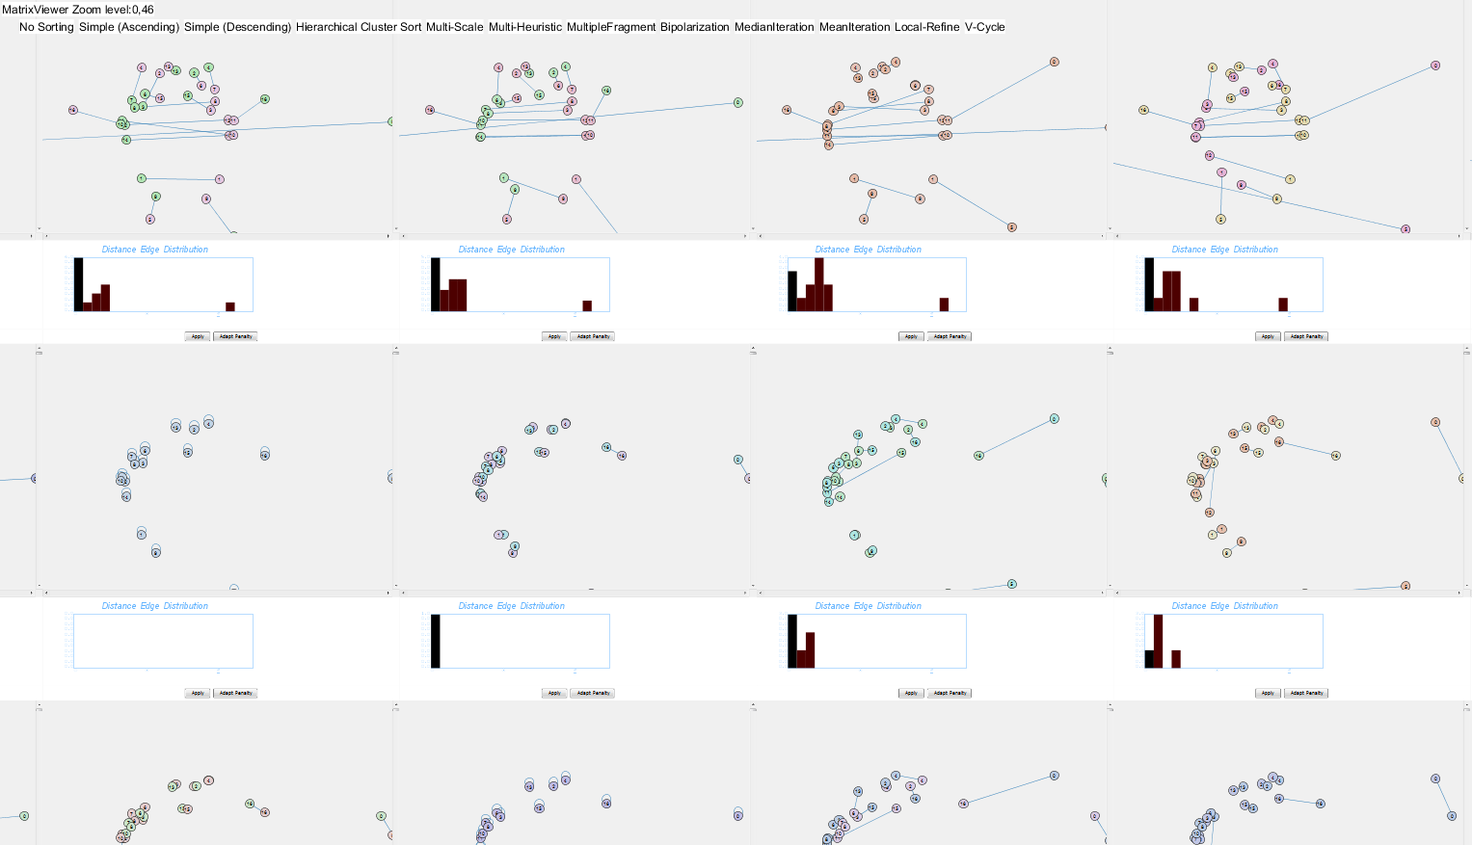
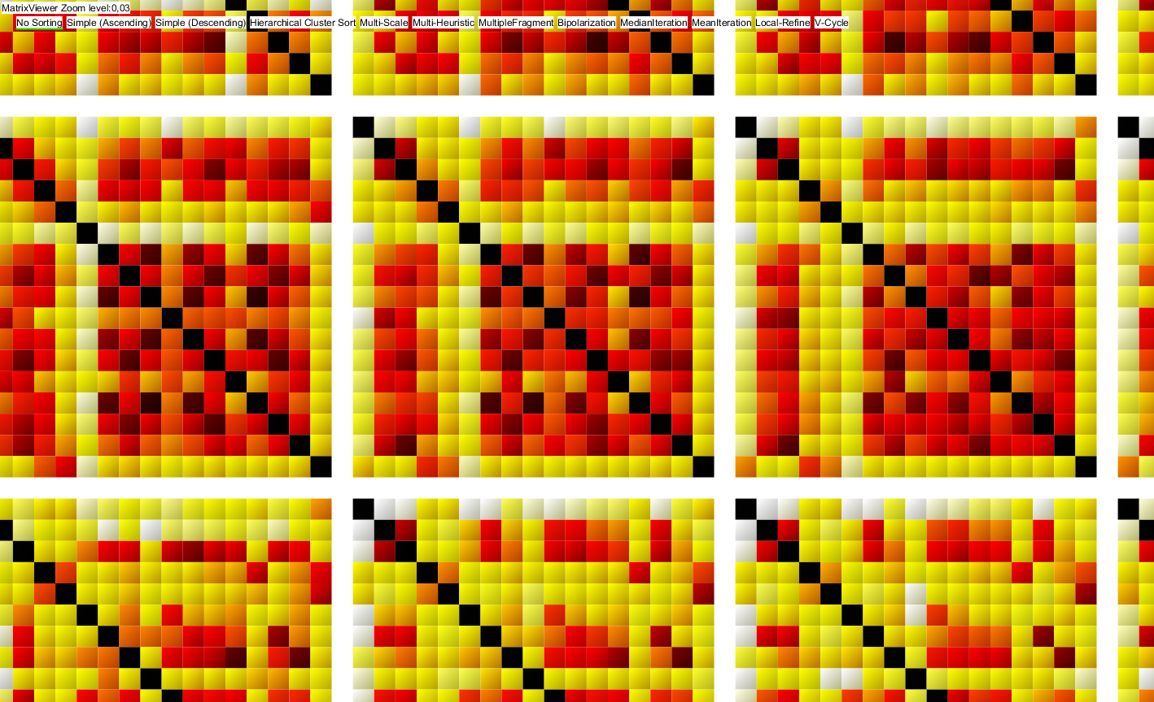
Individual Matrix View
Distance Matrix Semantic Zoom Interface
(c)
(a)
(b)
(d)
Zoom Level
Overview
Detail
Zoom Level
Overview
Detail
Zoom Level
Overview
Detail
FinalSemanticZoom1

Slide 9
Individual Matrix View
Distance Matrix Semantic Zoom Interface
(c)
(a)
(b)
(e)
(d)
Zoom Level
Overview
Detail
Zoom Level
Overview
Detail
Zoom Level
Overview
Detail
FinalSemanticZoom1

Slide 10
Individual Matrix View
Distance Matrix Semantic Zoom Interface
(c)
(a)
(e)
(d)
(b)
Zoom Level
Overview
Detail
Zoom Level
Overview
Detail
Zoom Level
Overview
Detail
FinalSemanticZoom2

Slide 11
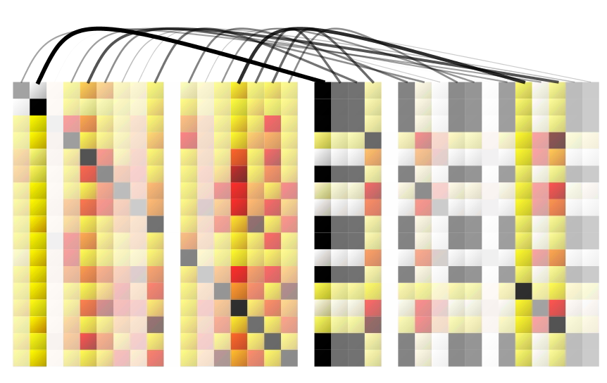
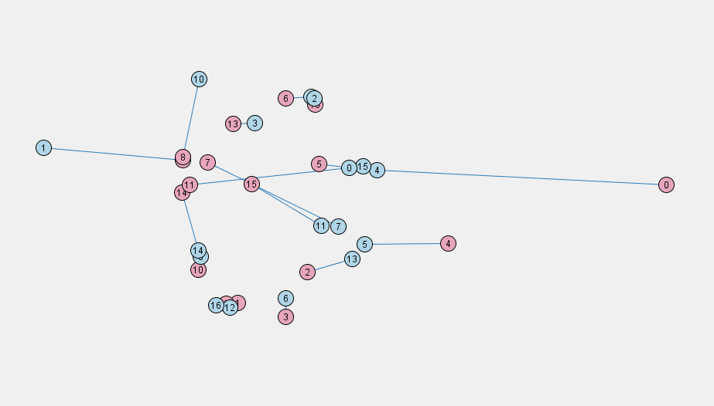
Placeholder Not Final Images
PlaceholderVisualInterpretation

Slide 12
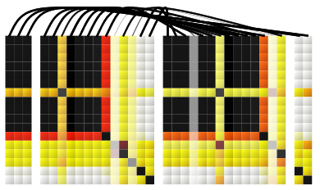
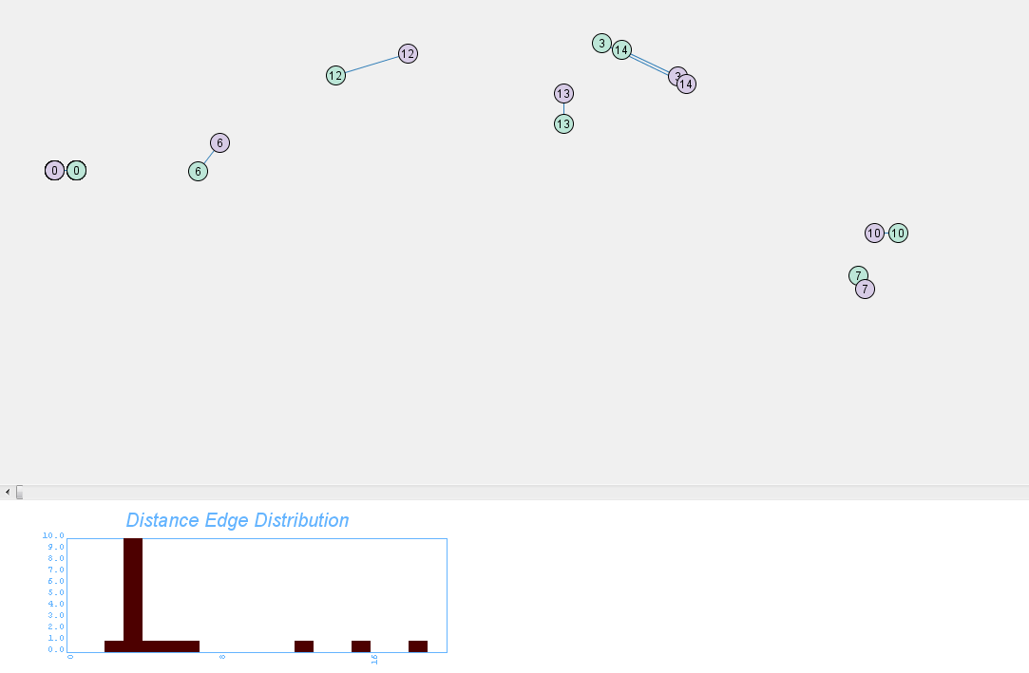
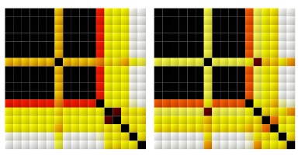
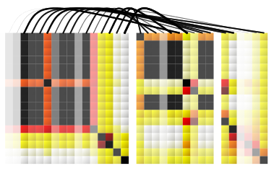
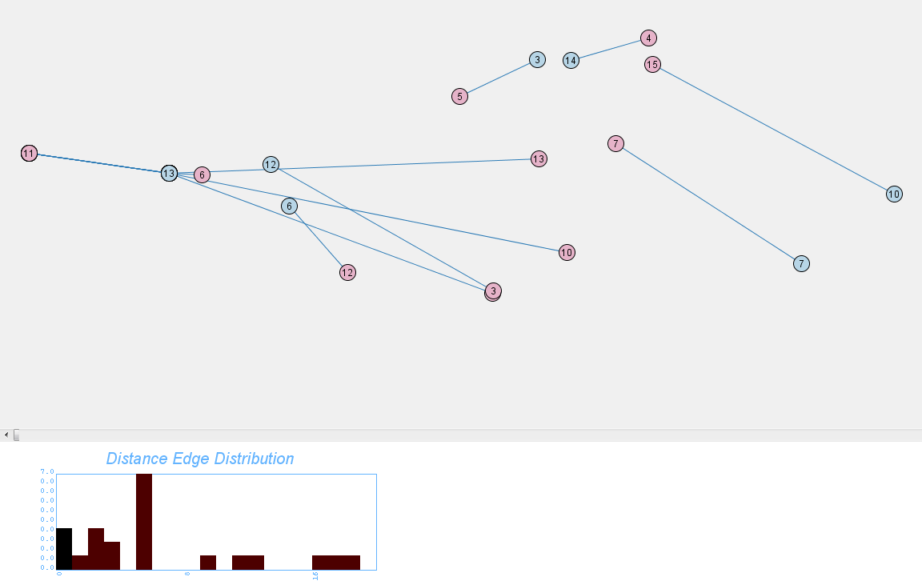
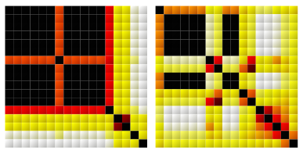
Juxtaposition of Matrix Images
Visual Depiction of the Distance Score
in the Image Space
Visual Depiction of the Distance Score
in the Projection Space
Similar Matrices
Dissimilar Matrices
FinalVisualInterpretation

Slide 13
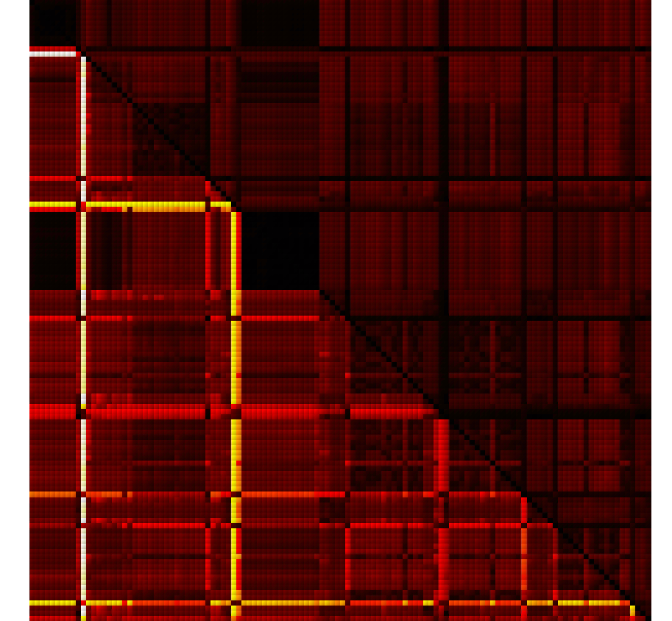
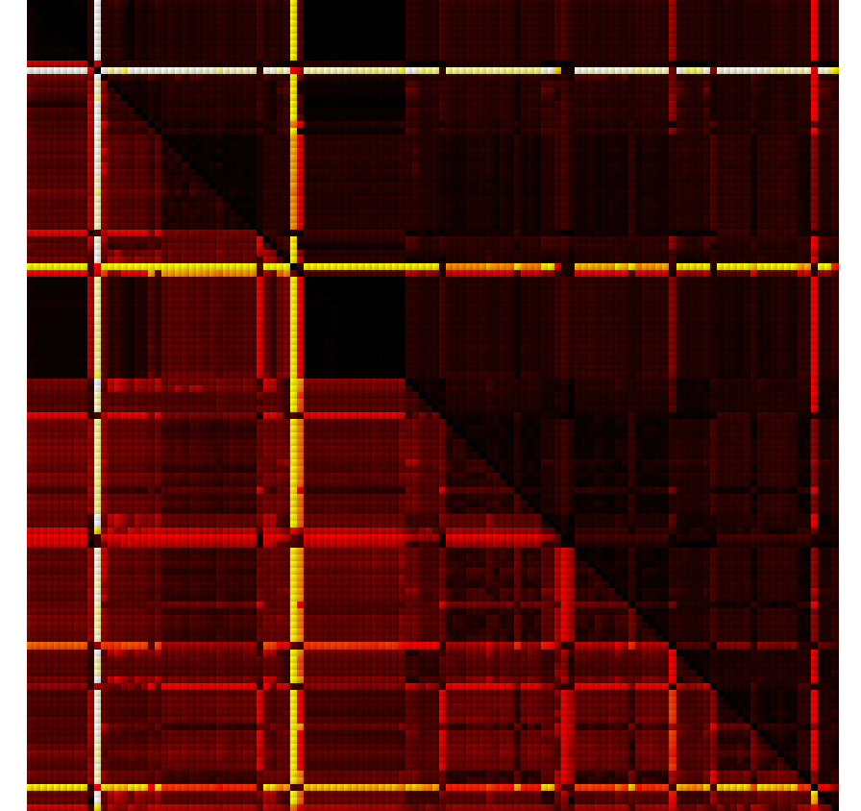
PlaceholderPenaltyFunctions

Slide 14
FinalPenaltyFunctions

Slide 15
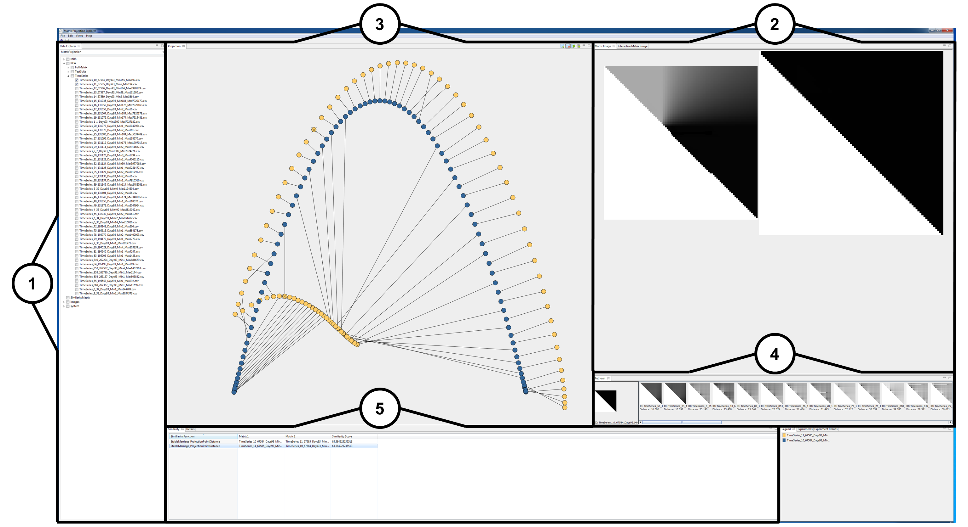
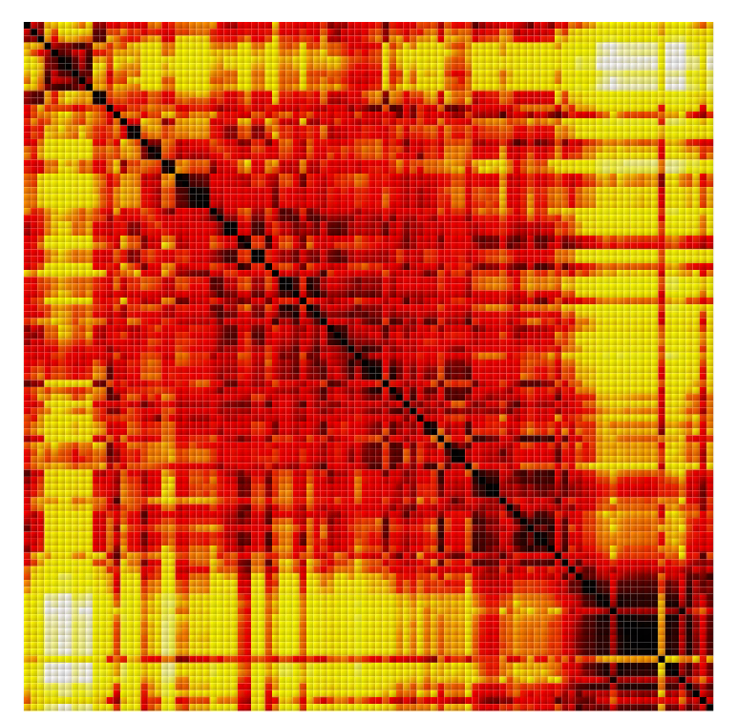
Placeholder Not Final Images
PlaceholderFrameworkFullResolution_Annotations

Slide 16
FinalFrameworkFullResolution_Annotations

Slide 17
FinalFrameworkFullResolution_Annotations

Slide 18
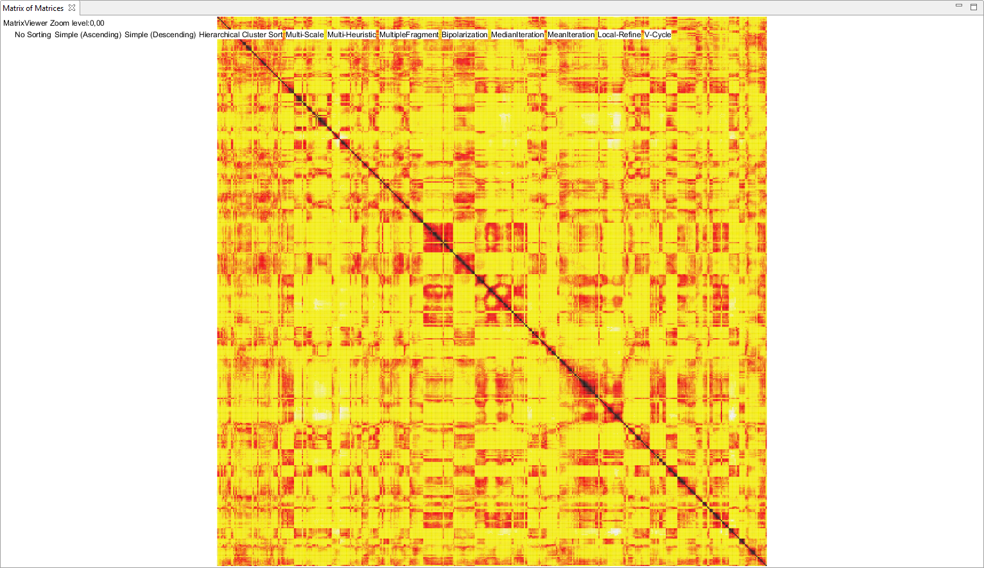
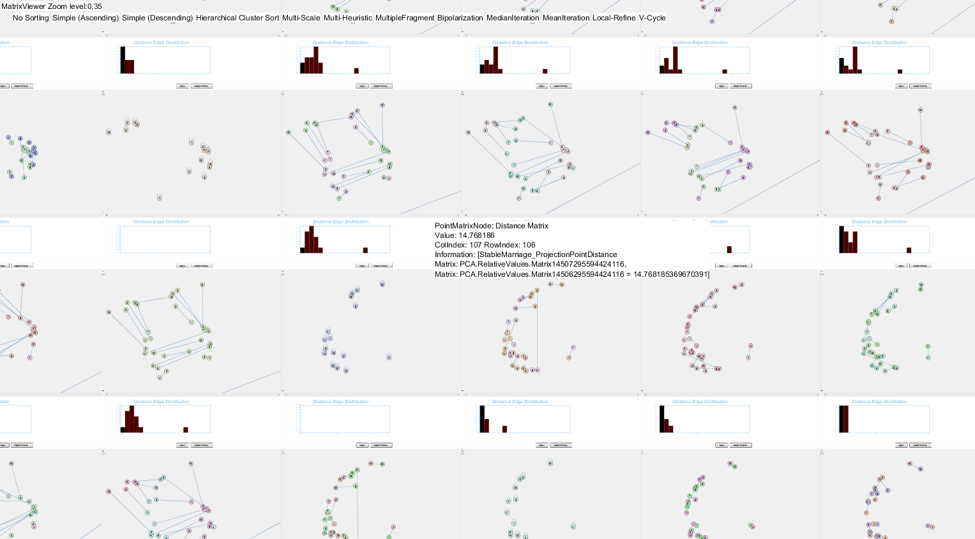
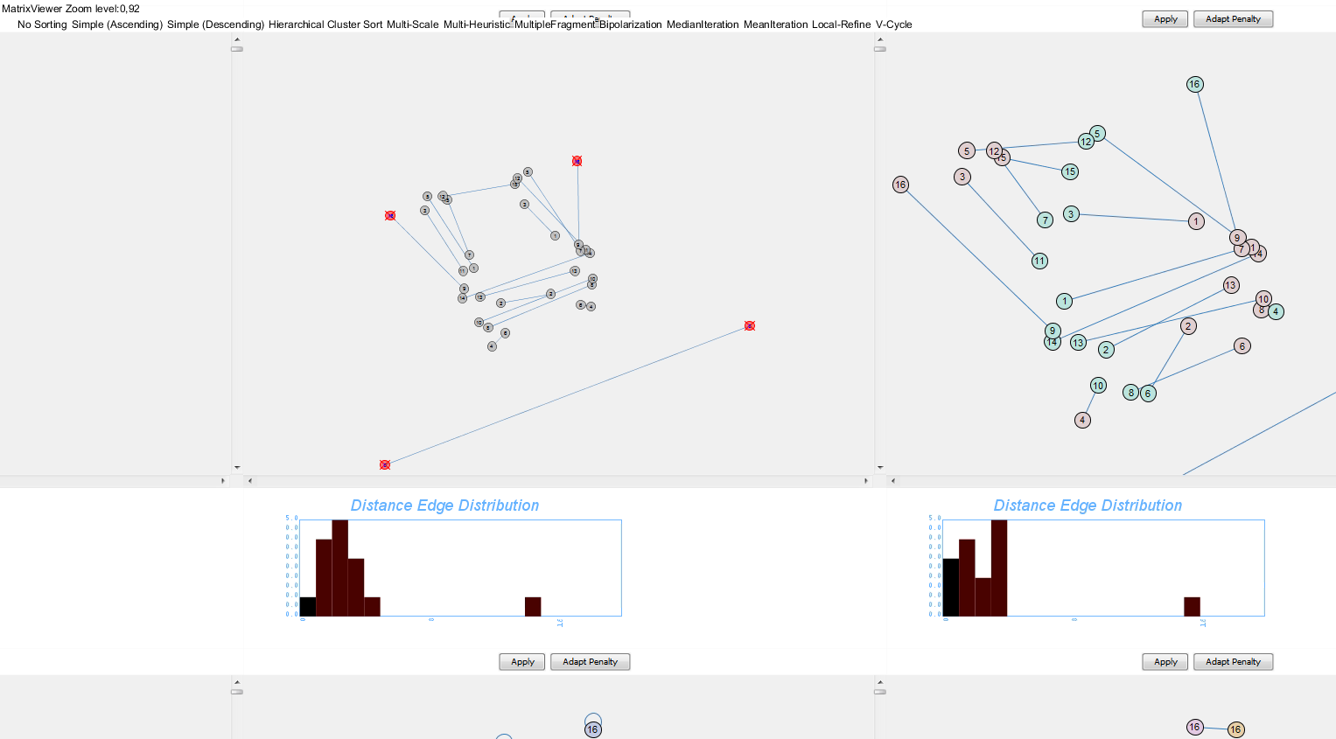
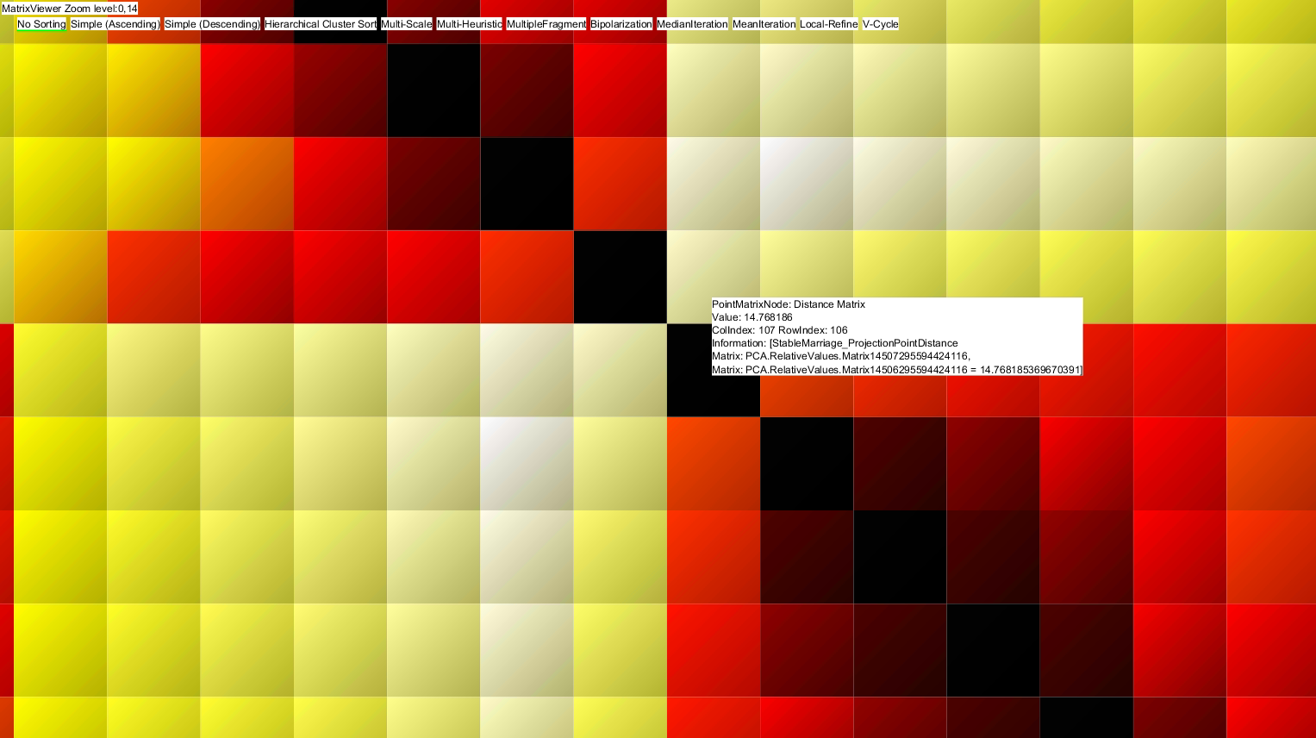
a
FinalDEBS2013
a

Slide 19
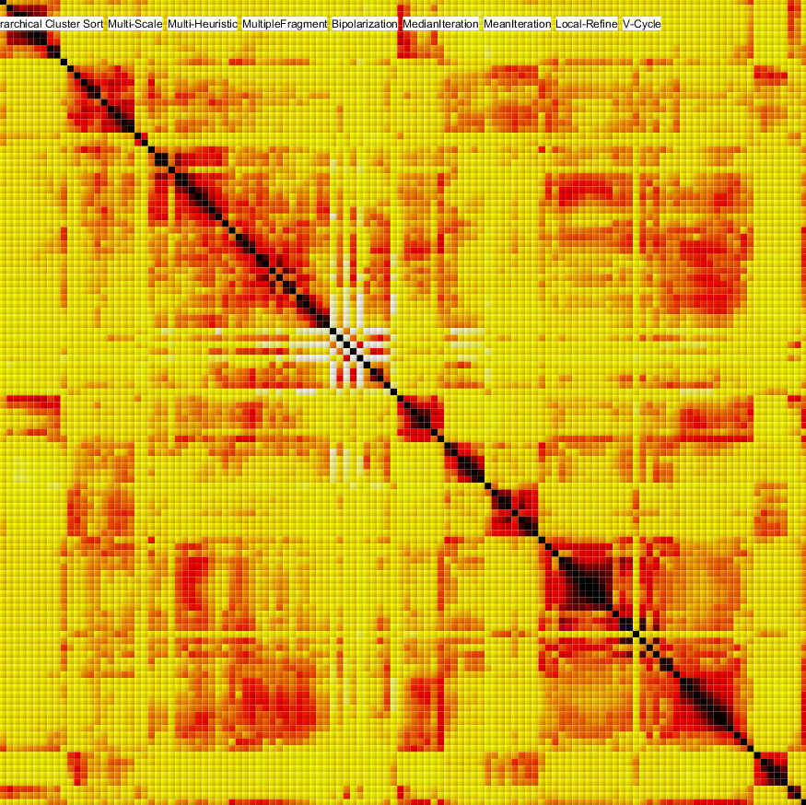
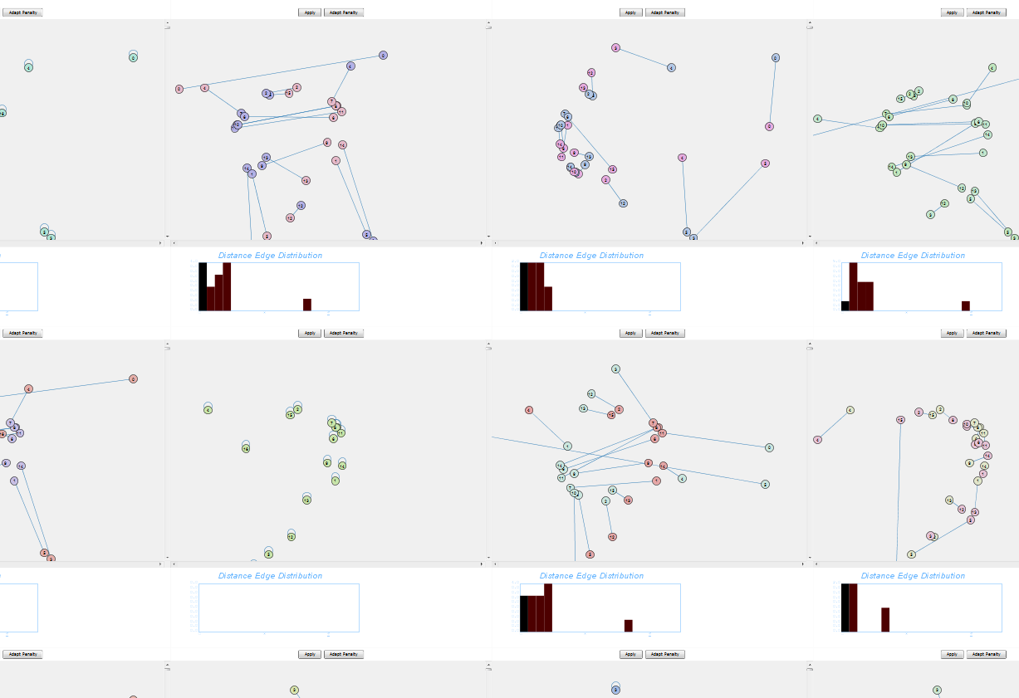
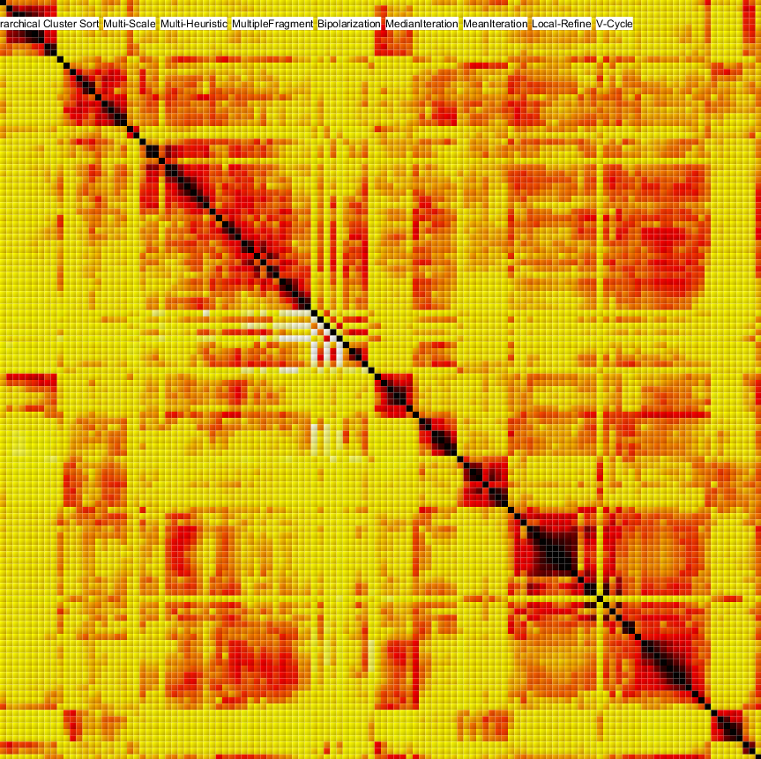
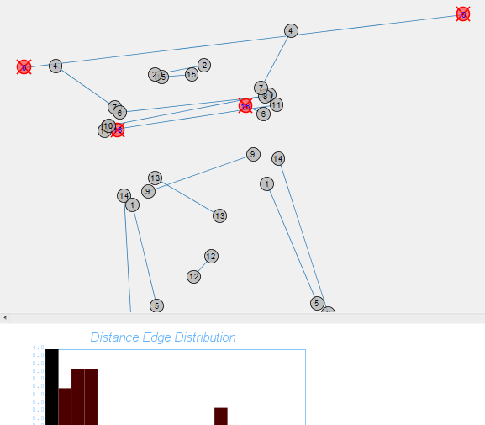
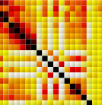
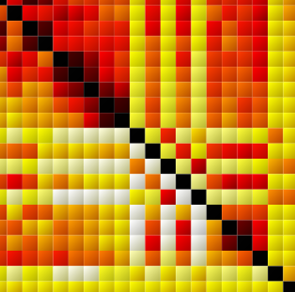
b
b
c
a
a
Final1DEBS2013
a

Slide 20
Placeholder Not Final Images

Slide 21
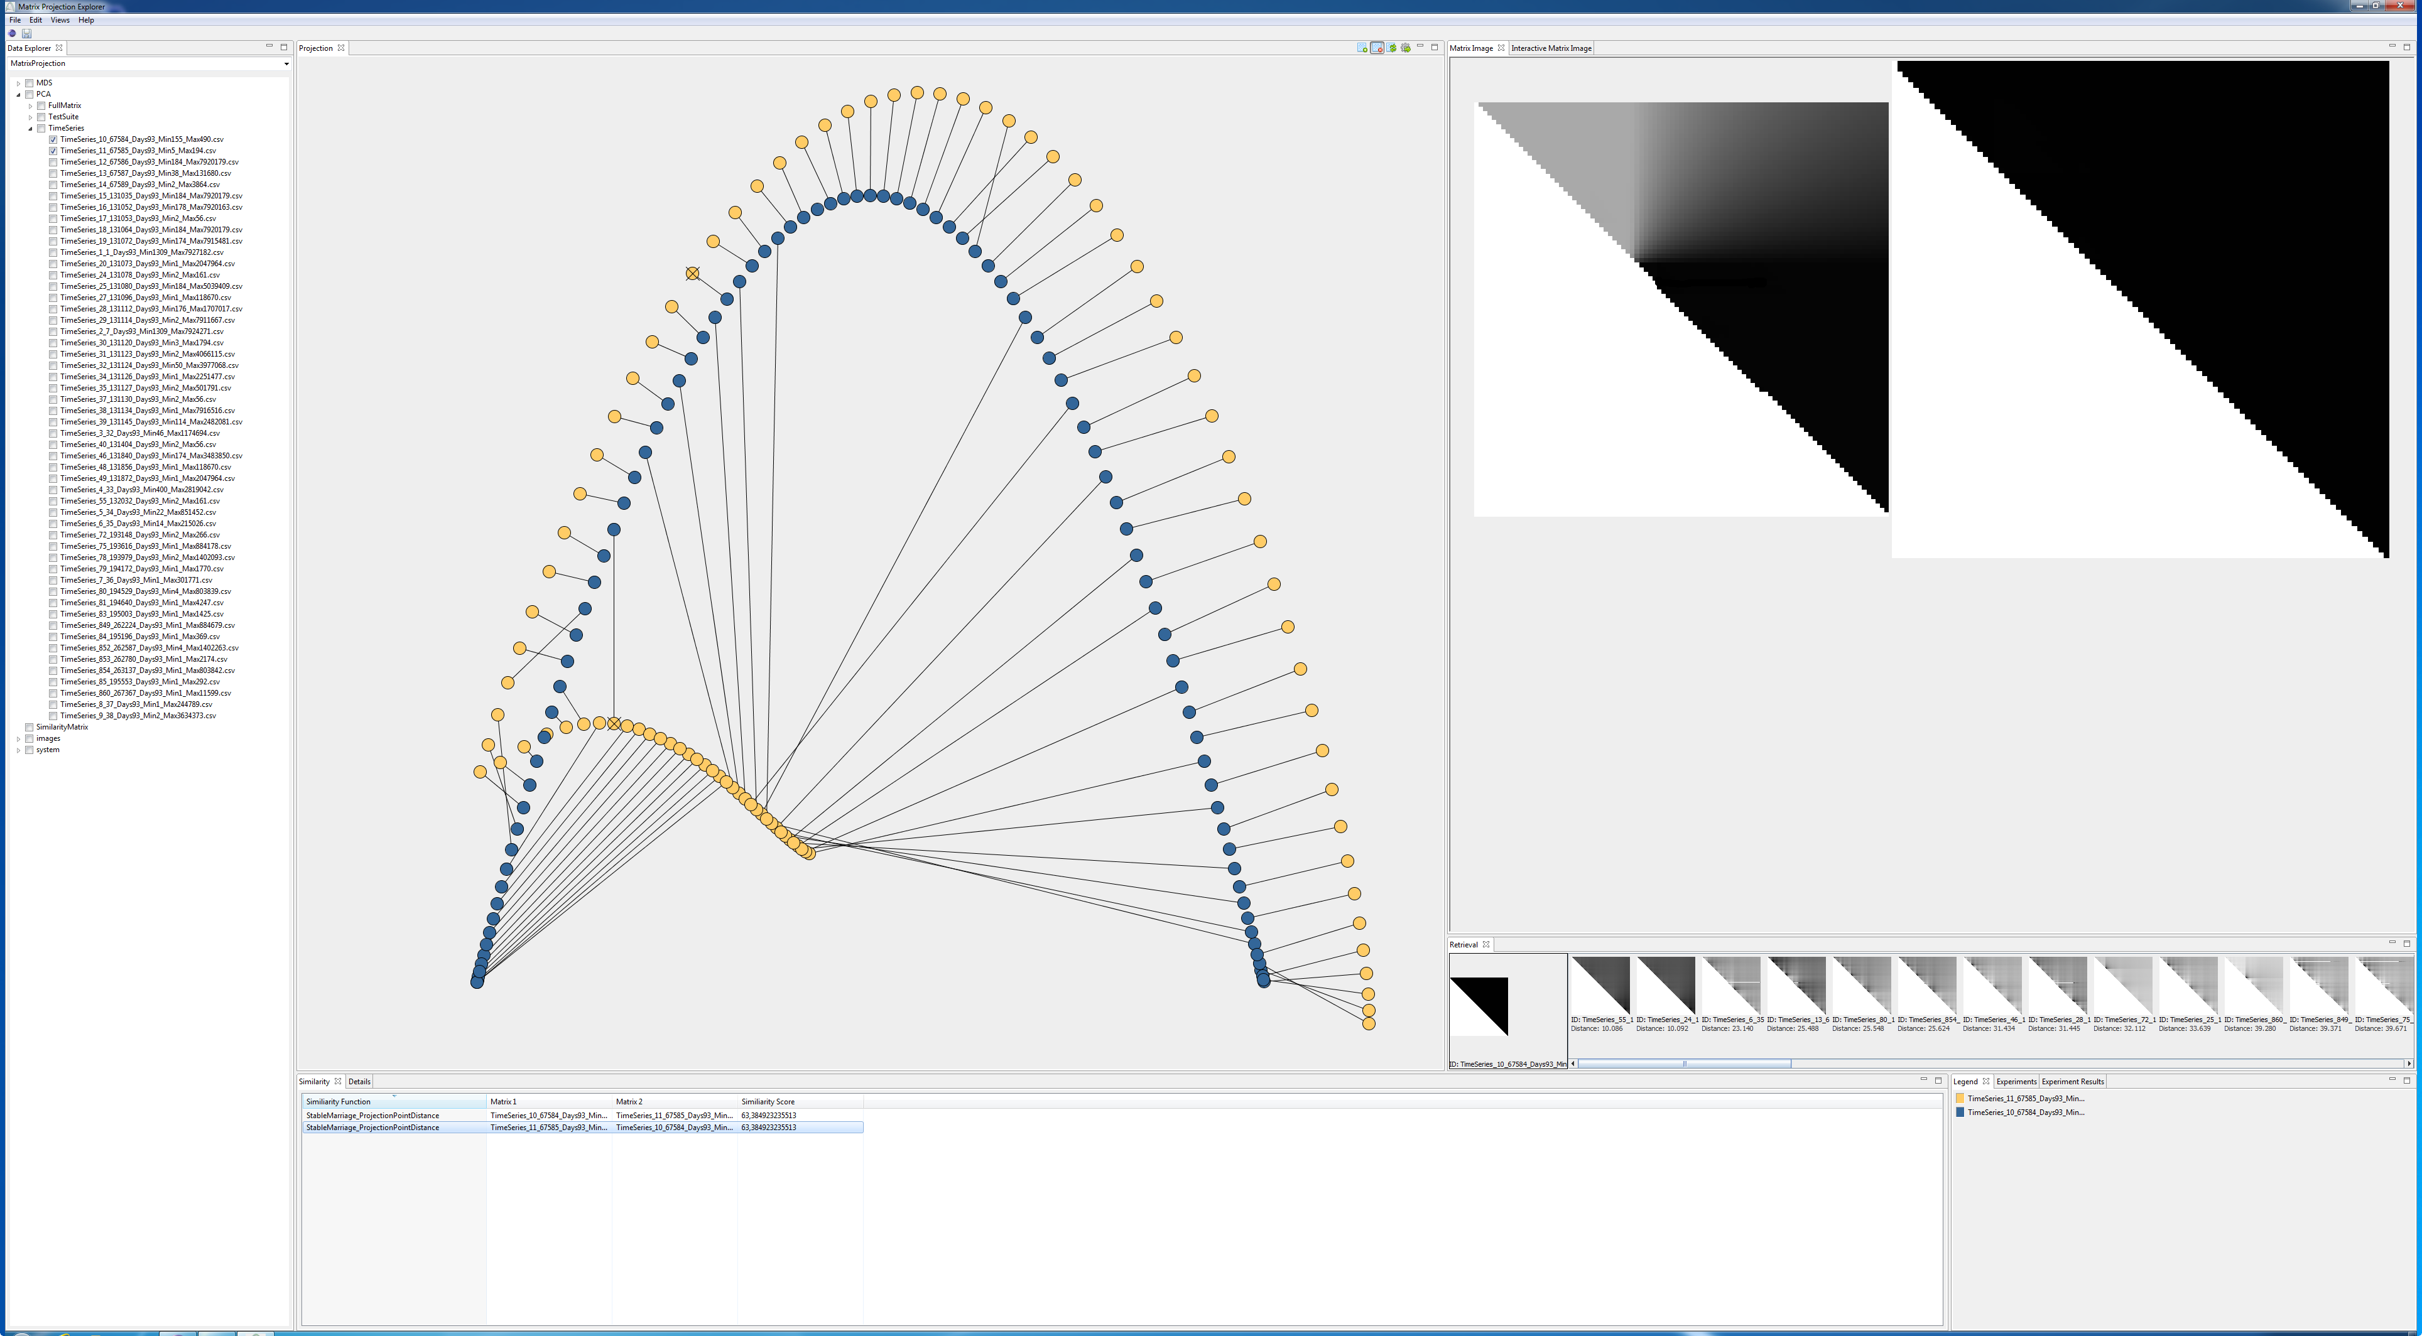
2
2
1

